Slide 1
Small scale industries financial growth
by,
k. janarthanan,
Iv year ece.

Slide 2
contents
Small Scale Industries (SSI)
Needs Of SSI
Characteristics
Financial Improvement Attributes
Advantages
Make In India.

Slide 3
Small scale industries
Small scale industries (SSI) are those industries in which manufacturing, providing services, productions are done on a small scale or micro scale.
scale levels depends on that less number of capital, labour.
The Indian government determine capital investment, requirements for small-scale industries. These requirements are listed under the Industries (Development and Regulation) Act, 1951.
Example :
1.Napkins 2. tissues 3.chocolates 4.toothpick
5. water bottles 6. small toys 7. papers, pens.

Slide 4
characteristics
ownership : sole proprietorship , a partnership.
limited reach : a restricted area of operations. so they meet local and
regional demand.
labor intensive : these small scale industries tend to use labour and
manpower for their production activities.
resources : they use local and readily available resources. this
helps the economy with better utilization of natural
resources and less wastage.

Slide 5
Role of ssi
Increases production
Increases total exports
Improves the employment rate
Opens new opportunities
Advances welfare

Slide 6
SSI Increases Production
SSI contribute almost 40% of india’s gross industrial value.
These industries produce goods and services worth over rs. 40 lakhs for every investment of rs. 10 lakhs. Furthermore, the value addition in this output increases by over 40%.
Here is another interesting statistic about small scale industries. The number of small scale industries in india increased from around 8 lakhs in 1980 to over 30 lakhs in 2022.

Slide 7
SSI Increases Export
50% of india’s total exports these days come from small-scale businesses.
35% of the total exports account for direct exports by ssis, while indirect exports amount to 15%.
Even trading houses and merchants help ssis export their goods and services to foreign countries.

Slide 8
SSI Advances Welfare
Small scale industries play a large role in advancing welfare measures in the indian economy as well.
A large number of poor and marginalized sections of the population depend on them for their sustenance.
These industries not only reduce poverty and income inequality but they also raise standards of living of poor people. Furthermore, they enable people to make a living with dignity

Slide 9
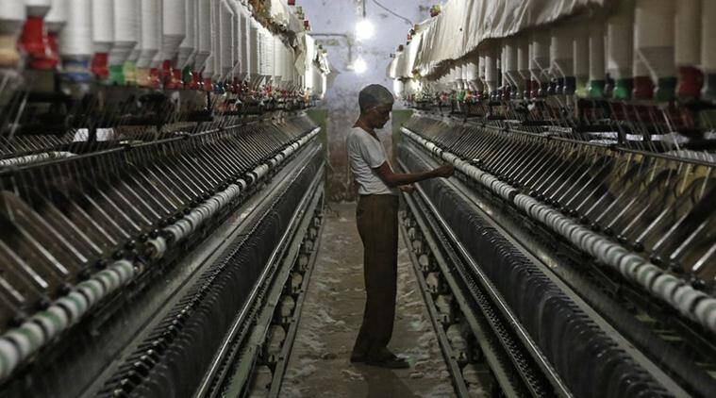
SSI Open New Opportunities
small-scale industries offer several advantages and opportunities for investments.
for example, they receive many tax benefits and rebates from the government. the opportunity to earn profits from ssis are big due to many reasons.
firstly, ssis are less capital intensive. they even receive financial support and funding easily.
secondly, procuring manpower and raw materials is also relatively easier for them. even the government’s export policies favour them heavily.
This Photo by Unknown Author is licensed under CC BY-SA-NC

Slide 10
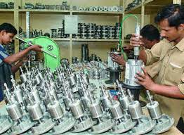

Slide 11
SSI Improves Employment Rate
It is important to note firstly that Small Scale Industries employs more people than all industries after agriculture.
Almost four persons can get full employment if Rs. 10 lakhs are invested in fixed assets of small-scale sectors.
Furthermore, SSIs employ people in urban as well as rural areas.
Consequently, this distributes employment patterns in all parts of the country and prevents unemployment crisis.

Slide 12
advantages
Requirement of less capital.
Contribution to industrial output.
Contribution to exports.
Earning foreign exchange.
Equitable distribution.
Use of domestic resources.
Opportunities for entrepreneurship.
Adaptability to change

Slide 13
MAKE IN INDIA
Name of the scheme | Make in India
LOGO | lion’s silhouette filled with cogs.
Date of launching | 25th September 2014
Launched by | PM Narendra Modi
Government Ministry | Ministry of Commerce and Industry

Slide 14
Eligibility Criteria for SSI Registration
Eligibility Criteria for SSI Registration
SSI registration can be obtained for enterprises that are considered as micro and small enterprises under the MSME Act, 2006.
A micro enterprise is an enterprise whose investment in plant, machinery and equipment does not exceed Rs.1 crore, and turnover does not exceed Rs.5 crore.
A small enterprise is an enterprise whose investment in plant, machinery and equipment does not exceed Rs.10 crore, and turnover does not exceed Rs.50 crore.

Slide 15
THANK YOU

